Slide 1
Social Media Platform
SMP

Slide 2
What is it?
A social media platform allows for the creation and sharing of information and other ideas through online communities and networks.
A typical social media platform will have a page to view a large amount of information (the feed), a page to view individual items (posts), and a page to view individual user information (profiles).
Additionally, a platform may include a user activity page, a messages page, or a search / discovery page.
Sitemaps display the pages on a site and the navigational relationship between them (how you get to one page from another).
Pagemaps display the design of individual pages.

Slide 3
Sitemap Example
Messages Page
Home Page
Search Page
Post Page

Slide 4




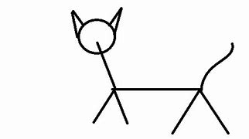



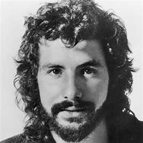


Pagemap Example
CATS
Messages Page
Home Page
Search Page
Post Page

Slide 5
Your Task
Develop a social media platform website with the following components
Home / Feed page
Profile page
Post page
Before creating the website, design a sitemap to organize the navigational relationships.
Before creating the pages on the website, design pagemaps to organize the information displayed on each page.
You will submit your sitemap and pagemaps along with your website.
You will present your website to the class.

Slide 6
SMP Project Rubric
Up to 3 BONUS POINTS for creativity and originality
Content | Design | Technical Expertise
3: Project includes all of the following components: - Home / Feed Page - Profile Page - Post Page | 3: Design and user flow of the website is intuitive and causes minimal frustration to the user | 3: Project makes use of a majority of web design components discussed in class in a way that makes sense for the design of the project
2: Project is missing one of the above components | 2: Up to two instances of poor design | 2: N/A
1: Project is missing two of the above components | 1: Up to five instances of poor design | 1: N/A
0: Project is missing more than two components or was not attempted | 0: More than five instances of poor design or was not attempted | 0: Project uses little to no web design components discussed in class or was not attempted

Slide 7
SMP Presentation Rubric
Presentation Skills | Knowledge | Team Synergy (solo = instant 3)
3 – Presenter(s) had less than 3 awkward pauses and filler words | 3 – Presenter(s) answered all student and teacher questions sufficiently | 3 – Presenter(s) distributed work evenly amongst themselves
2 – Up to 5 occasions | 2 – Up to 2 occasions of insufficient answers given | N/A
1 – Up to 10 occasions | 1 – Up to 4 occasions given | 1 – Present(ers) did not evenly distribute work amongst themselves
0 – More than 10 occasions or not attempted | 0 – More than 4 occasions or not attempted | 0 – No attempt

